Slide 1

Chapter 3
URL Mapping, Views, and Templates

Slide 2

Objectives
This chapter introduces you to three core concepts of Django: views, templates, and URL mapping.
Exploring the two main types of views in Django: function-based views and class-based views.

Slide 3
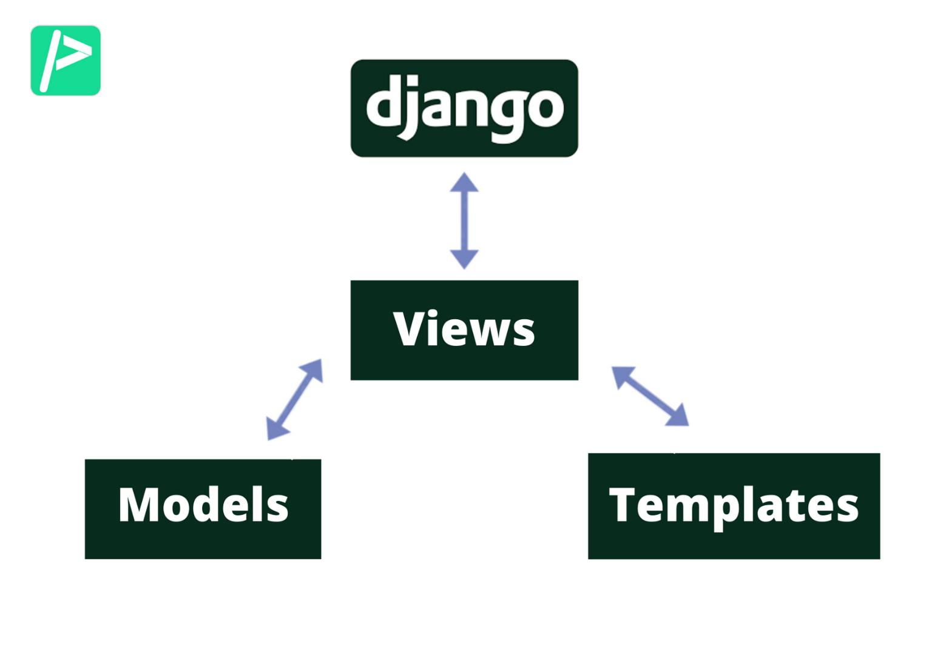
Introduction

Slide 4
Introduction
Views are the part of a Django application that takes in a web request and provides a web response.
Views are one of the most important parts of a Django application, where the application logic is written.
Django views can be broadly classified into two types, function-based views and class-based views.

Slide 5
Function-Based Views

Slide 6
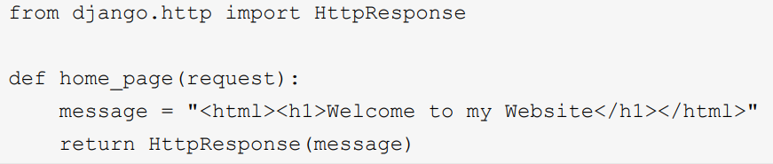
Function-Based Views
The view function defined here, named home_page, takes a request object as an argument and returns an HttpResponse object having the Welcome to my Website message.

Slide 7
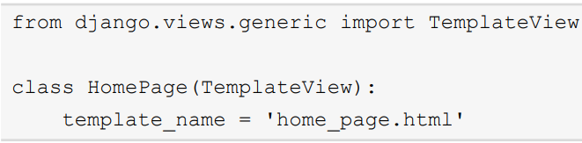
Class-Based Views
As the name implies, class-based views are implemented as Python classes. Using the principles of class inheritance, these classes are implemented as subclasses of Django's generic view classes.

Slide 8
Class-Based Views
HomePage is a class-based view inheriting Django's TemplateView from the django.views.generic module.
Add an HTML file to our templates folder with the following content:

Slide 9
URL Configuration
Django views cannot work on their own in a web application. When a web request is made to the application, Django's URL configuration takes care of routing the request to the appropriate view function to process the request.

Slide 10
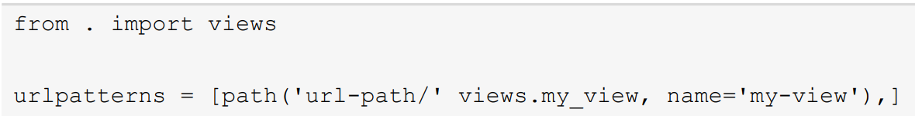
URL Configuration
urlpatterns is the variable defining the list of URL paths, and 'url-path/' defines the path to match.
views.my_view is the view function to invoke when there is a URL match.
name='my-view' is the name of the view function used to refer to the view

Slide 11
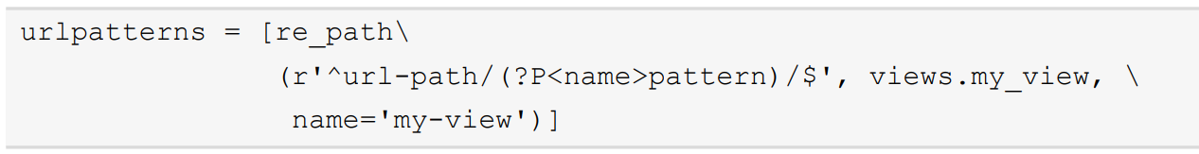
URL Configuration
We can also use a regular expression in a URL path to match string patterns using re_path().

Slide 12
URL Configuration
<int:id> tells Django to look for URLs that contain an integer at this position in the string, and to assign the value of that integer to the id argument.

Slide 13
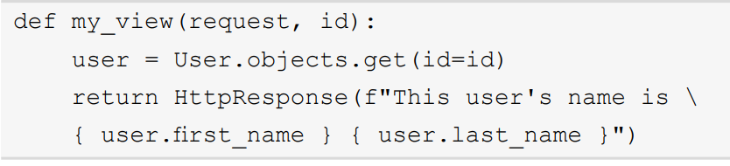
URL Configuration
An HTTP request would be made to the running application for the URL path. Upon receiving the request, it reaches for the ROOT_URLCONF setting present in the settings.py file:

Slide 14

URL Configuration
This determines the URL configuration file to be used first. In this case, it is the URL file present in the project directory project_name/urls.py

Slide 15
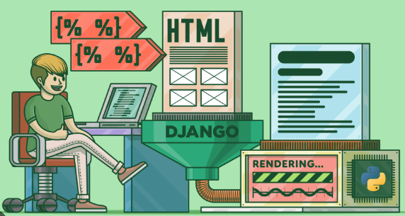
Templates

Slide 16
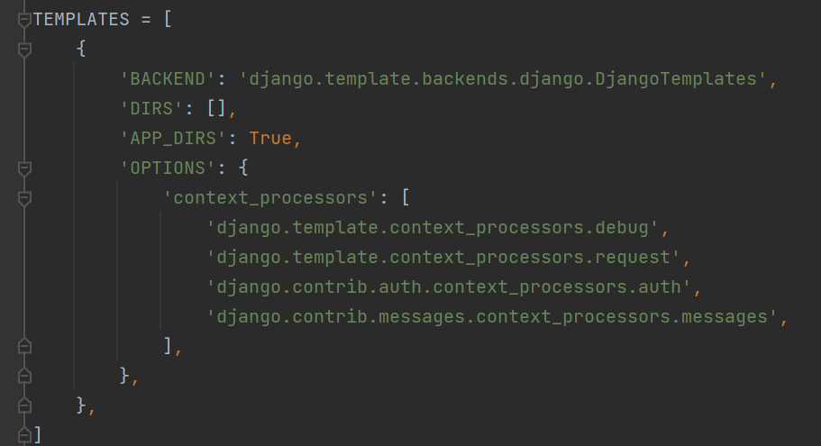
Templates
Django's template configuration is done in the TEMPLATES variable present in the settings.py file.

Slide 17
Templates
'BACKEND’: 'django.template.backends.django. DjangoTemplates’:
This refers to the template engine to be used. A template engine is an API used by Django to work with HTML templates.

Slide 18
Templates
'DIRS': []: This refers to the list of directories where Django searches for the templates in the given order.
'APP_DIRS': True: This tells the Django template engine whether it should look for templates in the installed apps defined under INSTALLED_APPS in the settings.py file.

Slide 19
Templates
'OPTIONS': This is a dictionary containing template engine-specific settings.

Slide 20
Django Template Language

Slide 21

Template Variables
A template variable is represented in between two curly braces, as shown here:

Slide 22
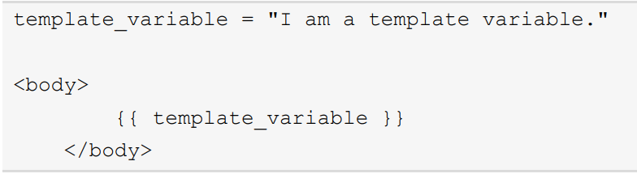
Template Tags
Template variables help in adding the application's data into the templates.

Slide 23
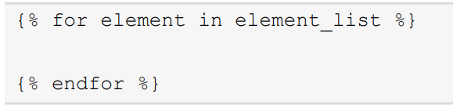
Template Tags
A tag is similar to a programmatic control flow, such as an if condition or a for loop.

Slide 24
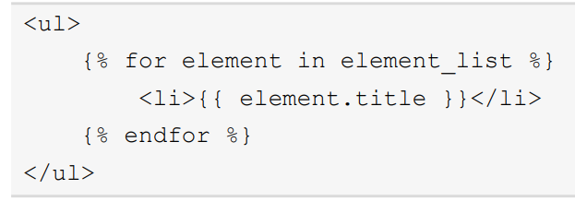
Template Tags
Add the end of the control flow by adding the end tag, such as {% endfor %}

Slide 25
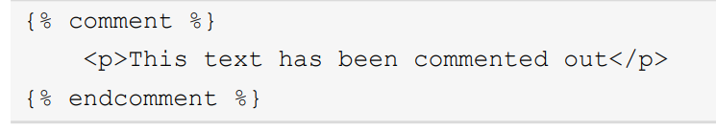
Comments
Comments in the Django template language can be written as shown here; anything in-between {% comment %} and {% endcomment %} will be commented out:

Slide 26

Filters
Here are some examples of built-in filters:
• {{ variable|lower }}: This converts the variable string into lowercase.
• {{ variable|title}}: This converts the first letter of every word into uppercase.

Slide 27
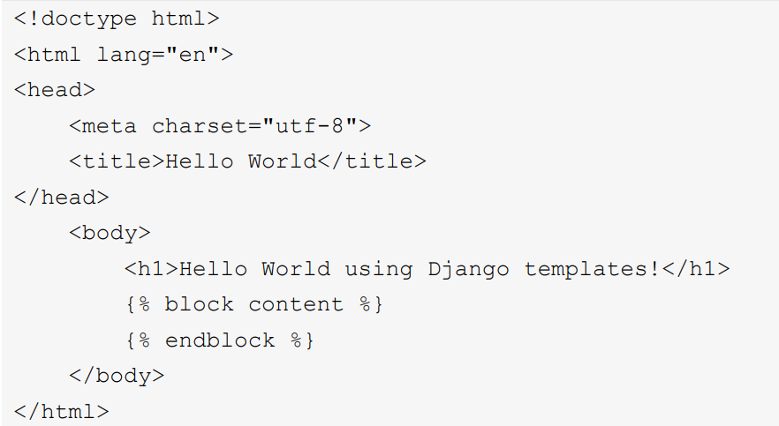
Template Inheritance
let's consider the following to be a parent template that is named base.html:

Slide 28
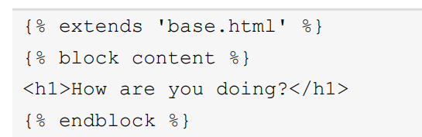
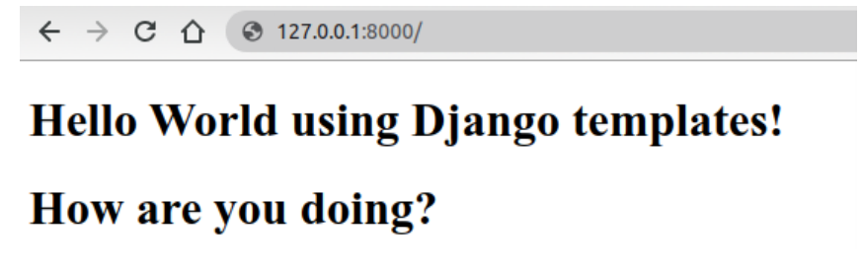
Template Inheritance
The following is an example of a child template:

Slide 29
Template Styling with Bootstrap

Slide 30
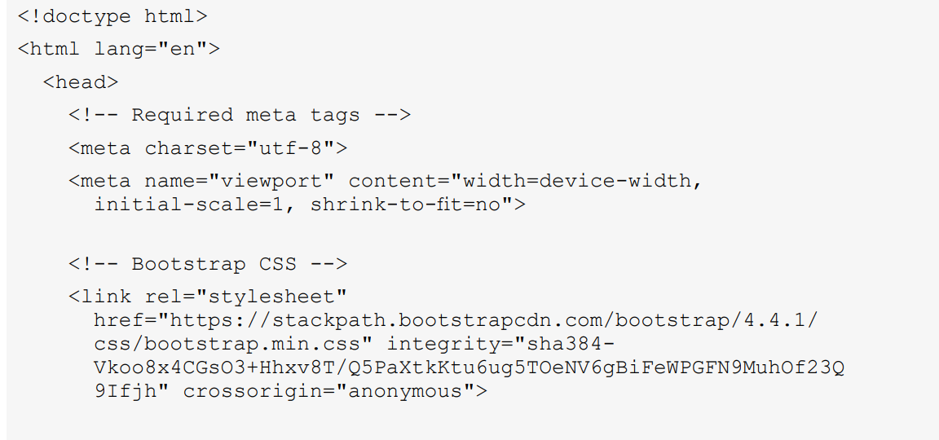
Template Inheritance
We can add a few elements of Bootstrap

Slide 31
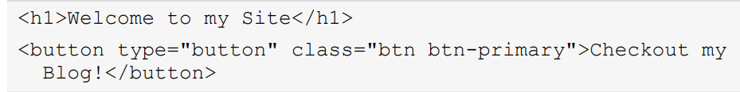
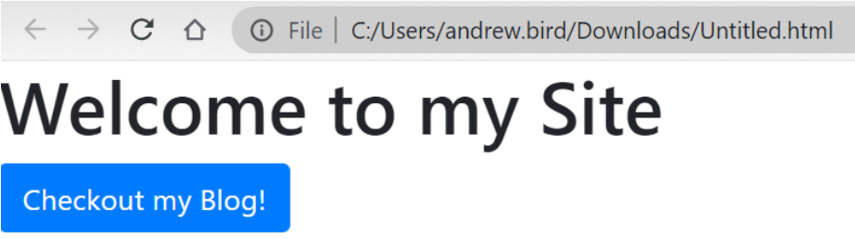
Template Inheritance
Try adding the following between <body></body>

Slide 32
Summary
- This chapter covered the core infrastructure required to handle an HTTP request to our website.
The view is responsible for compiling any necessary information to display on the website.
We covered both class- and function-based views and learned about the Django template language and template inheritance

